Slide 1
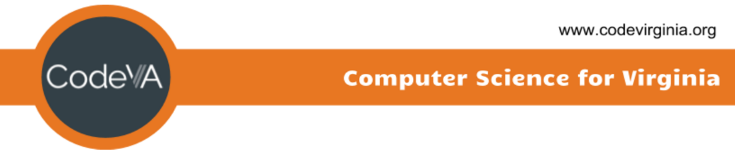
Coding Lesson 2
Number Calculations and Data Types
Elementary Coaches Academy

Slide 2
Learning Objective
Discover the math operators used in Python
Learn about different data types
See what happens when operators are used on the wrong data type

Slide 3
Warm up
Open the starter File
https://repl.it/repls/TroubledOldRouter

Slide 4
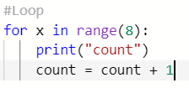
Warm up
Change the loop to make count print 1 additional time.

Slide 5
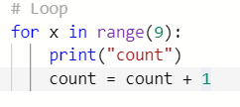
Warm up
Notice we change range(8) to range(9) so now count must equal 9 instead of 8 for the loop to complete.

Slide 6
Let’s Do the Math
The whole purpose of early computers was to do number calculations. They were really just big calculators.

Slide 7
Definition: Operations
The number calculations a computer program can do.
What examples of operations did we see in this program?

Slide 8
Lab Lecture
What math operators are built into Python?
+, -, *, /, %, and MORE

Slide 9
Lab Lecture
Change your program so it asks the user to enter a number:
Print the number multiplied by 20.

Slide 10

Lab Lecture
First assign the “num” variable to hold the number you want to multiply, then print that number out in the same line that you multiply by 20.
Note int(input(“words”)) can be used to specify that an integer number should be taken as input.

Slide 11
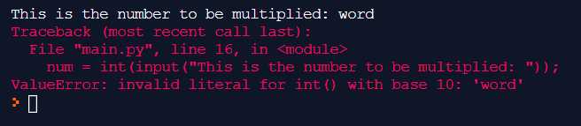
Lab Lecture
What happens when you enter a word instead of a number?

Slide 12
Lab Lecture
Python gave you an error because it was expecting an integer number but was given a string of characters.

Slide 13
Definition: Data Type
The kind of data a user types in
Numbers used for calculations
Words NOT used for calculations
Some books call these Strings

Slide 14

Lab Lecture
Change your program so it asks the user to enter a number:
Print the number divided by 10.
Do you get a decimal?

Slide 15
Lab Lecture
Change your program so it asks the user to enter a number:
Try sqrt() function on the entered number.

Slide 16


Lab Lecture

Slide 17

Lab Lecture
Input a number
Display the number MOD 10
Notes:
Show them how to create a variable in the data menu

Slide 18
Lab Lecture
What does MOD do?
Display the number MOD 5
Notes:
Show them how to create a variable in the data menu

Slide 19
Definition: MOD
Gives the remainder when doing division.

Slide 20
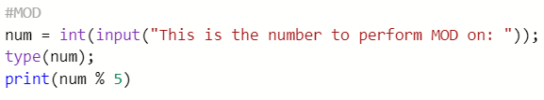

MOD 5

Slide 21
MOD is used for:
Patterns in programs (Pac Man)
Colors
Changing bases:
Time
Money
Checking if numbers divisible (even/odd)

Slide 22
Lab Lecture
Try MOD:
4
3
17
Notes:
Show them how to create a variable in the data menu

Slide 23
Lab Lecture
If we do MOD 4
How many possible answers?
Lowest?
Highest?
Notes:
Show them how to create a variable in the data menu

Slide 24
Practice Exercises
https://docs.google.com/document/d/1YxlbBjvfb-V0VwXBZE62oRJFSxTgOpHW/edit
Mild - perfect for beginners
Medium - expanding your skills
Spicy - looking for a challenge?

Slide 25
Journal
What are some ways data types can be taught using other subjects that you already teach?

